Slide 1
Econ 100 Principles of Economics
Lecture 15
April 24

Slide 2
Today:
-A brief summary of last lecture
-Government Control on prices
-Assignment 6 will be available this Wednesday till Friday midnight since we have the midterm this Saturday

Slide 3
On Wednesday, the week before spring break:
Welfare economics and the efficiency of competitive markets

Slide 4
Welfare and the equilibrium of the competitive market
The total surplus (consumer surplus + producer surplus) is maximized at the market equilibrium.
Therefore, the competitive equilibrium is efficient.

Slide 5
Evaluating the Market Equilibrium
Buyers
Free markets allocate the supply of goods to the buyers who value them most highly, as measured by their willingness to pay.
Sellers
Free markets allocate the demand for goods to the sellers who can produce them at least cost.

Slide 6
Consumer and Producer Surplus in the Market Equilibrium
Price
A
D
Supply
Consumer
surplus
F
Equilibrium
E
price
Producer
surplus
Demand
B
C
0
Equilibrium
Quantity
quantity
Copyright©2010 South-Western

Slide 7
Now something slightly more complicated

Slide 8
Supply, Demand, and Government Policies

Slide 9
Government control on prices
Price floors (minimum price)
Price ceilings (maximum price)

Slide 10
In a free market system, market forces (demand and supply) determine the equilibrium prices and the equilibrium quantities (produced and consumed) of goods and services.
The competitive equilibrium is efficient, but it may be true that not everyone is satisfied.
Notes:
2
2

Slide 11
CONTROLS ON PRICES
They are used when policymakers believe the market price is unfair to buyers or sellers.
They take the form of government-created price ceilings and price floors.
Notes:
3
3

Slide 12
CONTROLS ON PRICES
Price Ceiling
A legal maximum on the price at which a good can be sold. The market price cannot be higher than this legal maximum.
Price Floor
A legal minimum on the price at which a good can be sold. The market price cannot be lower than this legal minimum.
Notes:
4
4

Slide 13
What is the effect of each of the following on the market where they are applied?
A price floor of P = 0 TL in the market for good X
A price ceiling of P = 0 TL in the market for good Y

Slide 14
How Price Ceilings Affect Market Outcomes
To be effective the price ceiling must be below the equilibrium price.
Notes:
5
5

Slide 15

The equilibrium with the maximum price (price ceiling)
With the maximum price at P_{L} Q_{D} > Q_{S} there is a shortage of Q_{D} – Q_{S} units.
With the maximum price at P_{L} only Q_{S} units are traded in the equilibrium
We observe that Q_{S} < Q₀, the “free” market equilibrium quantity.
Price
S
P_{o}
The maximum price at P_{L}
D
Q_{S}
Q_{o}
Q_{D}
Quantity

Slide 16
How Price Ceilings Affect Market Outcomes
Price Ceilings create shortages: Q_{D} > Q_{S}.
They also create non-price rationing: long lines, discrimination by sellers.
Notes:
14
11

Slide 17
Government control on prices
An example for the maximum price is rent controls.
American soldiers returning from World War II found apartment costs in New York to be unaffordable.
As a result, the City of New York instituted a price ceiling on rent.

Slide 18
Now
Minimum prices (price floors)

Slide 19
The equilibrium with the minimum price (price floor)
With a minimum price at P_{H} we have Q_{S} > Q_{D} there is a surplus of Q_{S} – Q_{D} units.
With the minimum price at P_{H} only Q_{D} units are traded in the equilibrium
We observe that Q_{D} < Q₀, the “free” market equilibrium quantity.
Price
S
The minimum price at P_{H}
P_{o}
D
Q_{D}
Q_{o}
Q_{S}
Quantity

Slide 20
Government control on prices
An example for the minimum price is the minimum wage.

Slide 21

How the Minimum Wage Affects the Labor Market
Wage
Labor
Supply
Equilibrium
wage
Labor
demand
0
Equilibrium
employment
Quantity of
Labor
Copyright©2003 Southwestern/Thomson Learning

Slide 22
How the Minimum Wage Affects the Labor Market
Wage
Labor
Supply
Labor surplus
(unemployment)
Minimum
wage
Labor
demand
0
Quantity
demanded
Quantity
supplied
Quantity of
Labor
Copyright©2003 Southwestern/Thomson Learning

Slide 23
Summary

Slide 24
Government control on prices
A price ceiling (a maximum price)
If the government imposes a maximum price in a market, then the price of the good cannot be higher than this maximum price.
As a result, the quantity demanded exceeds the quantity supplied .
A price ceiling (a maximum price) creates a shortage (excess demand).

Slide 25
Government control on prices
A price floor (a minimum price)
If the government imposes a minimum price in a market, then the price of the good cannot be lower than this minimum price.
As a result, the quantity supplied exceeds the quantity demanded.
A price floor (a minimum price) creates a surplus (excess supply).

Slide 26
Price controls reduce total welfare

Slide 27
A price floor and the efficiency loss
The government sets a price floor at P_{H}.
Now the price must be at least P_{H} or higher.
Price
Deadweight Loss
Lost Consumer Surplus
S
New Consumer Surplus
P_{H}
P_{o}
Lost Producer Surplus
New Producer Surplus
D
Q_{L}
Q_{o}
Quantity

Slide 28
A price ceiling and the efficiency loss
The government sets a price ceiling at P_{L}.
Now the price cannot be higher than P_{L} .
Price
Deadweight Loss
Lost Consumer Surplus
S
New Consumer Surplus
P_{o}
Lost Producer Surplus
New Producer Surplus
P_{L}
D
Q_{L}
Q_{o}
Quantity

Slide 29
Your turn now

Slide 30
The government sets a price ceiling (maximum price) of 45.
Compute the quantity bought and sold.
Compute the consumers surplus with the price ceiling.
Compute the producers surplus with the price ceiling.
Buyer’s name | Buyer’s WtP |  | Seller’s name | Seller’s cost
A | 85 |  | A | 35
B | 80 |  | B | 40
C | 75 |  | C | 45
D | 70 |  | D | 50
E | 65 |  | E | 55
F | 60 |  | F | 60
G | 55 |  | G | 65
H | 50 |  | H | 70

Slide 31
The government sets a price floor (minimum price) of 70.
Compute the quantity bought and sold.
Compute the consumers surplus with the price floor.
Compute the producers surplus with the price floor.
Buyer’s name | Buyer’s WtP |  | Seller’s name | Seller’s cost
A | 85 |  | A | 35
B | 80 |  | B | 40
C | 75 |  | C | 45
D | 70 |  | D | 50
E | 65 |  | E | 55
F | 60 |  | F | 60
G | 55 |  | G | 65
H | 50 |  | H | 70

Slide 32
Now a similar example with the Demand and Supply graphs

Slide 33
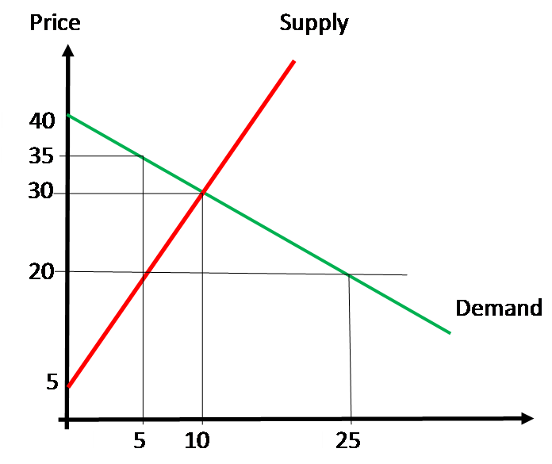
1 Compute the equilibrium price and quantity.
Compute the consumers surplus and the producers surplus in the free market equilibrium.
2 The government sets a price ceiling (maximum price) of 20.
Compute the quantity bought and sold. Compute the consumers surplus and the producers surplus with the price ceiling.
3 The government sets a price floor (minimum price) of 35.
Compute the quantity bought and sold. Compute the consumers surplus and the producers surplus with the price floor.

Slide 34
Market distortion

Slide 35
A case of inefficiency: Government control on prices
A price floor (also known as a minimum price) is a legal minimum on the price of a good or service.
If the government imposes a minimum price in a market, then the buying and selling price of the good cannot be lower than this minimum price.
An example is the minimum wage.
As a result of the minimum price, the quantity supplied exceeds the quantity demanded.

Slide 36
Loss in Efficiency Too High of Price (Price Floor) Ex. Minimum wage
Price
Deadweight Loss
Lost Consumer Surplus
S
New Consumer Surplus
P_{H}
P_{o}
Lost Producer Surplus
New Producer Surplus
D
Q_{L}
Q_{o}
Quantity

Slide 37
A recent debate
To lift the hourly minimum gradually?

Slide 38
A letter to Mr. Obama
Over 600 Economists Sign Letter In Support of $10.10
Minimum Wage
Economist Statement on the Federal Minimum Wage
Dear Mr. President, Speaker Boehner, Majority Leader
Reid, Congressman Cantor, Senator McConnell, and
Congresswoman Pelosi:

Slide 39
A letter to Mr. Obama
July will mark five years since the federal minimum wage was last raised. We urge you to act now and enact a three-step raise of 95 cents a year for three years—which would mean a minimum wage of $10.10 by 2016—and then index it to protect against inflation. Senator Tom Harkin and Representative George Miller have introduced legislation to accomplish this. The increase to $10.10 would mean that minimum-wage workers who work full time, full year would see a raise from their current salary of roughly $15,000 to roughly $21,000. These proposals also usefully raise the tipped minimum wage to 70% of the regular minimum.

Slide 40
A letter to Mr. Obama
This policy would directly provide higher wages for close to 17 million workers by 2016. Furthermore, another 11 million workers whose wages are just above the new minimum would likely see a wage increase through “spillover” effects, as employers adjust their internal wage ladders. The vast majority of employees who would benefit are adults in working families, disproportionately women, who work at least 20 hours a week and depend on these earnings to make ends meet. At a time when persistent high unemployment is putting enormous downward pressure on wages, such a minimum-wage increase would provide a much-needed boost to the earnings of low-wage workers.

Slide 41
A letter to Mr. Obama
In recent years there have been important developments in the academic literature on the effect of increases in the minimum wage on employment, with the weight of evidence now showing that increases in the minimum wage have had little or no negative effect on the employment of minimum-wage workers, even during times of weakness in the labor market. Research suggests that a minimum-wage increase could have a small stimulative effect on the economy as low-wage workers spend their additional earnings, raising demand and job growth, and providing some help on the jobs front.
Sincerely,
To see who signed the letter please visit
http://www.epi.org/minimum-wage-statement/

Slide 42
Unemployment from a Wage Above the Equilibrium Level
Wage
Surplus of labour
Labour
=
Unemployment
supply
Minimum
wage
W_{E}
Labour
demand
0
L_{D}
L_{E}
L_{S}
Quantity of
Labour

Slide 43
Does min wage cause unemployment? Survey results.

Slide 44
Does minimum wage laws cause unemployment?
Survey results from 44 US economists

Slide 45
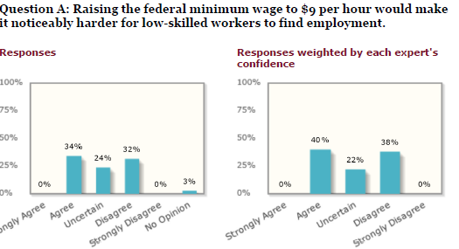
http://www.igmchicago.org/igm-economic-experts-panel/poll-results?SurveyID=SV_br0IEq5a9E77NMV

Slide 46
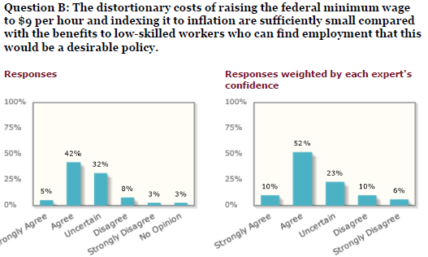

Slide 47




The panel:

Slide 48





Slide 49
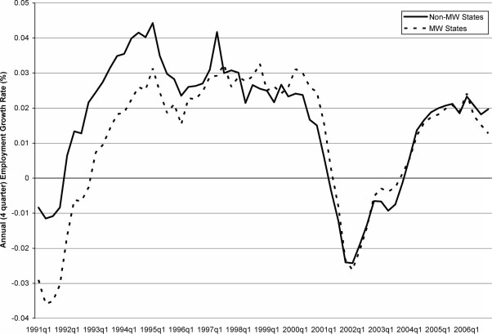
ANNUAL EMPLOYMENT GROWTH RATE, MINIMUM WAGE STATES VERSUS NON–MINIMUM WAGE STATES

Slide 50
Do free markets (‘invisible hand’) exist?

Slide 51
Do free markets (‘invisible hand’) exist?
“This year's Nobel Prize celebrates a critique of simplistic market economics, just as last year's award (of which I was one of the three winners) did. Last year's laureates emphasized that different market participants have different (and imperfect) information, and these asymmetries in information have a profound impact on how an economy functions.
In particular, last year's laureates implied that markets were not, in general, efficient; that there was an important role for government to play. Adam Smith's invisible hand - the idea that free markets lead to efficiency as if guided by unseen forces - is invisible, at least in part, because it is not there.”
Joseph Stiglitz, The Guardian, December 20, 2002

